Slide 1
Speaker Recognition System
Katrina Bykova

Slide 2
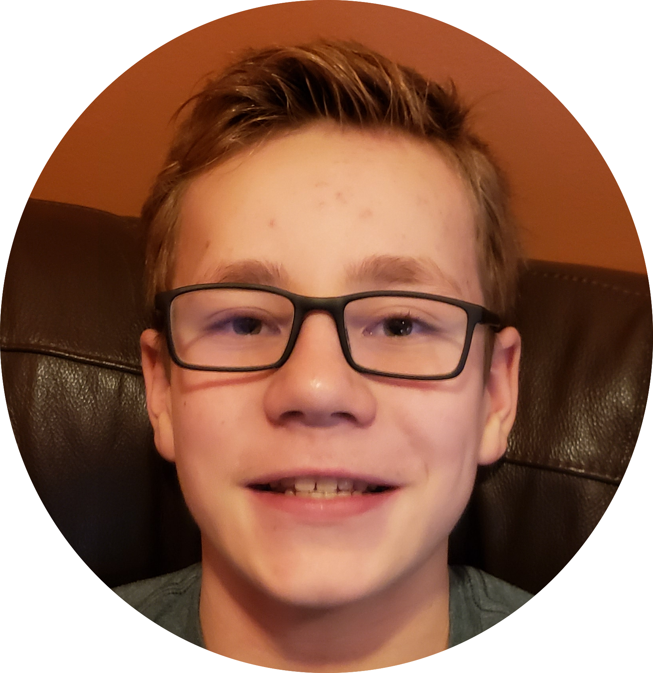
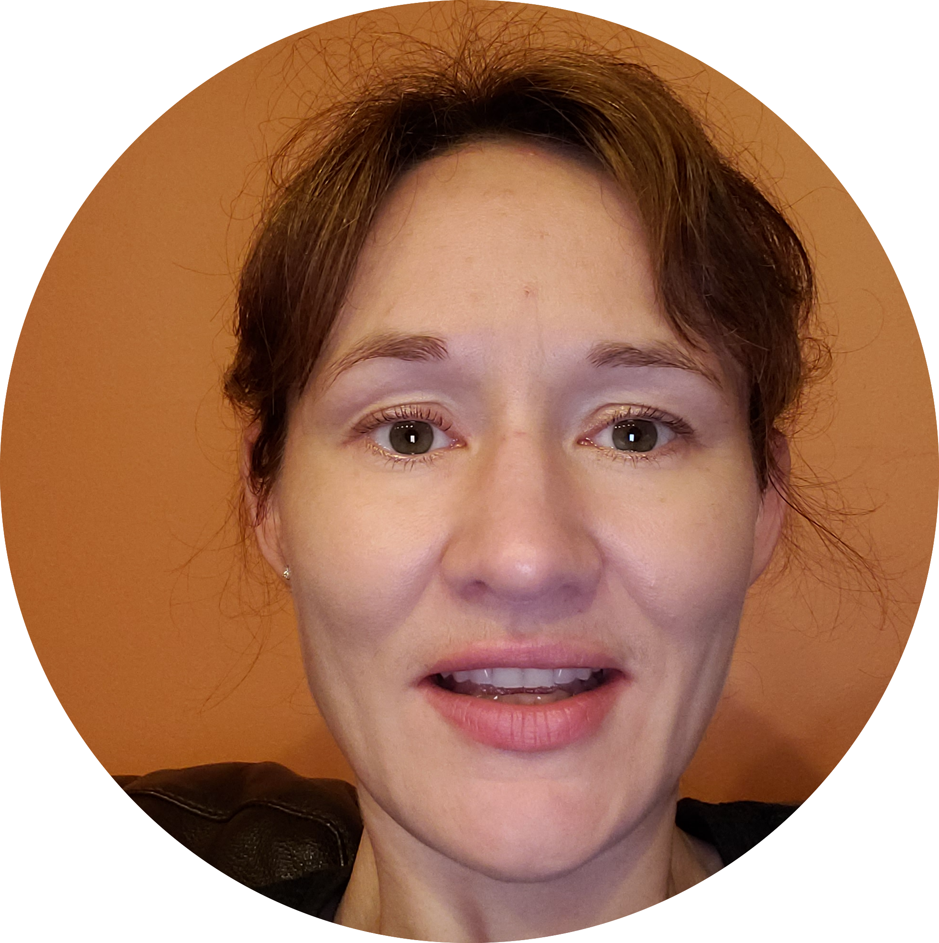
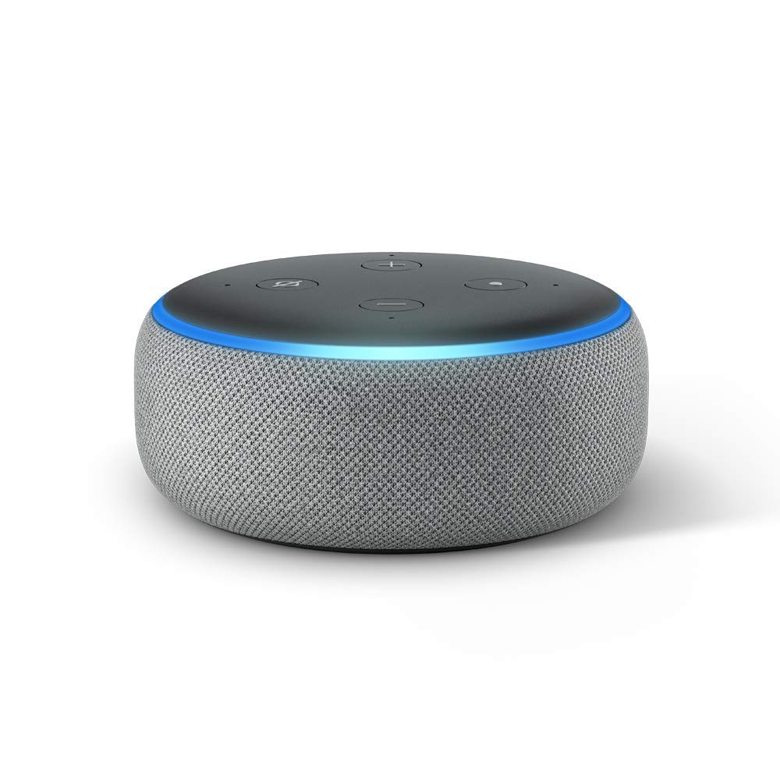
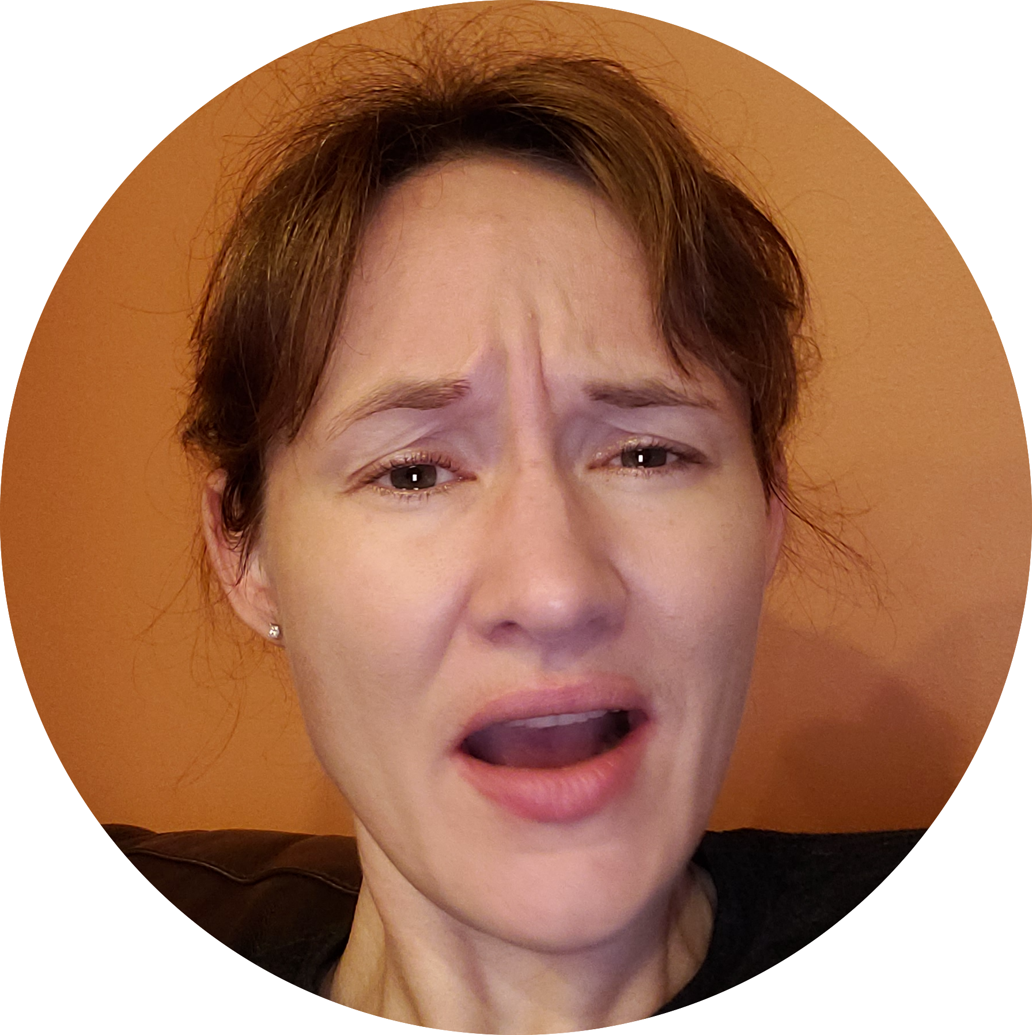
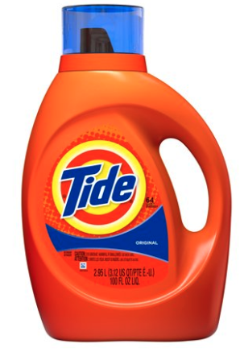

Alexa with a disabled speaker recognition
Alexa, order laundry detergent
Alexa, order Nintendo switch
Katrina
Misha
Amazon’s Alexa
Loves video games
Out of laundry detergent
Order has been placed
nice device
Order has been placed
What?!!
Katrina
+

Slide 3
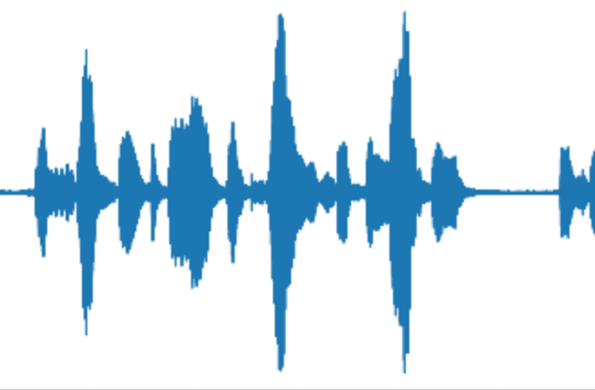

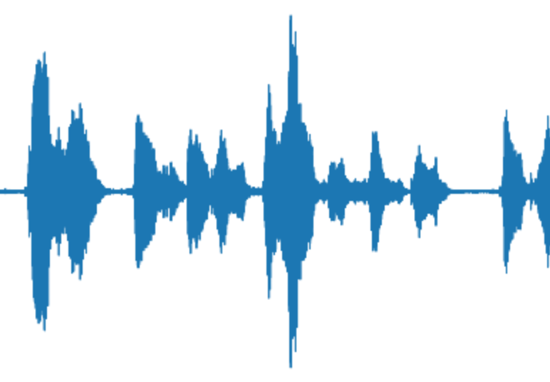

Speaker recognition algorithm
Public speech dataset
Audio processing
Feature generation
Model
Siamese networks
Spectrogram
VGG network
LibriSpeech
Audiobooks
1,000 speakers
3 sec. audios
|v1 - v2|

Slide 4
Speaker recognition algorithm
Public speech dataset
Audio processing
Feature generation
Model
Siamese networks
Spectrogram
Katrina
VGG network
Same speaker?
|v1 - v2|
Katrina
YES
v2

Slide 5
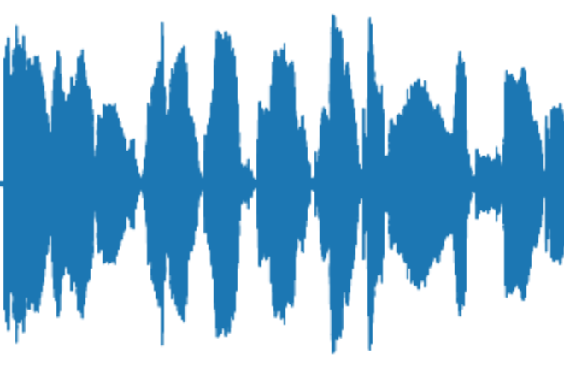
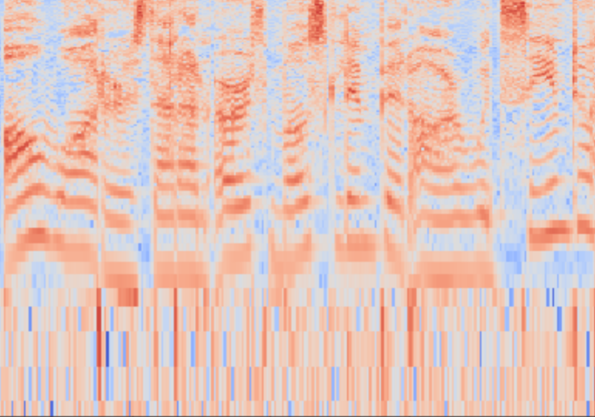
Speaker recognition algorithm
Public speech dataset
Audio processing
Feature generation
Model
Siamese networks
Spectrogram
Katrina
VGG network
Same speaker?
|v1 - v2|
NO
Misha
v2

Slide 6

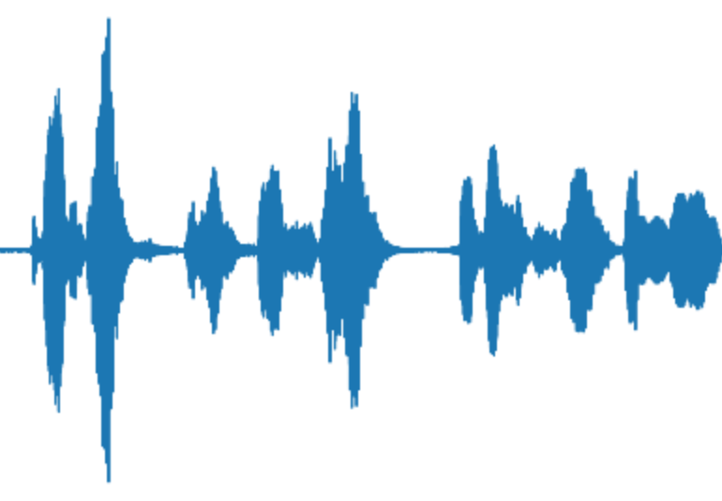
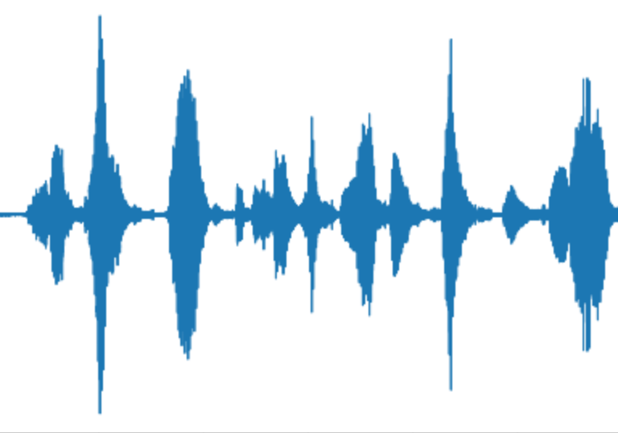
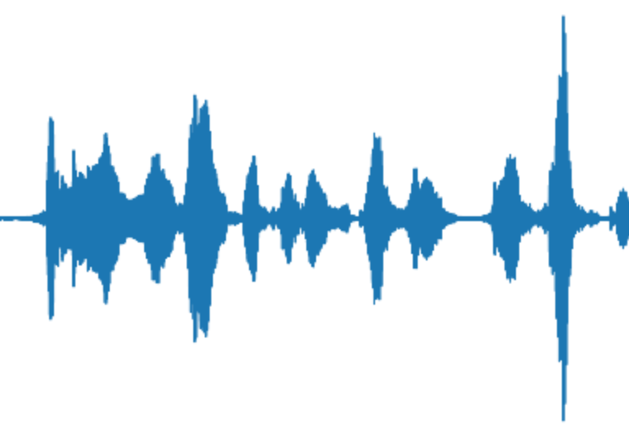
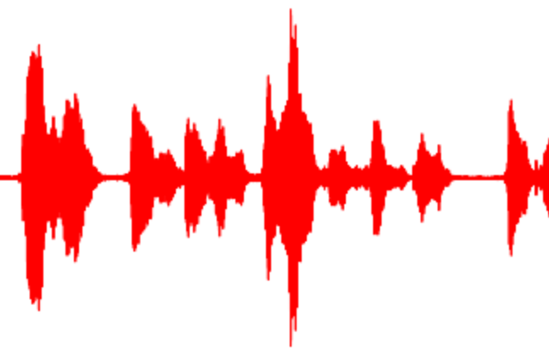
Speaker recognition algorithm performance
Algorithm
Algorithm performance
Error analysis
5 sample voiceprint
Accuracy 83%
Misclassified speakers
672-122797-0054
672-122797-0074

Slide 7
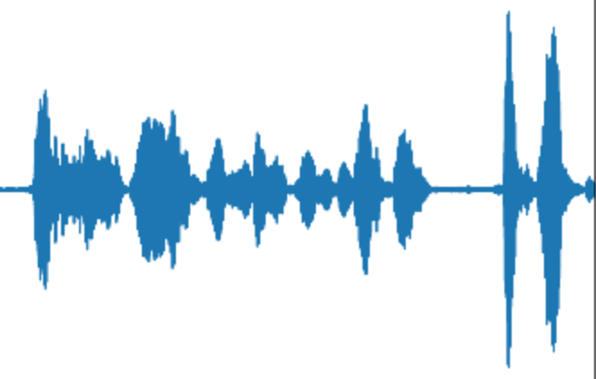
Alexa with an enabled speaker recognition
Stored Katrina’s voiceprint
Katrina
Same speaker?
Misha
Same speaker?
YES
NO
Order has been placed
I’m sorry, order can’t be placed
Just what I needed

Slide 8
Feature development
New data
Training
Evaluation
Collect audio datasets with speakers changing their voices
Train new models
Compare to existing models

Slide 9
Sound recognition by Home AI assistant
Katrina Bykova
katrina.bykova@gmail.com
Thank you

Slide 10
Sound recognition by Home AI assistant
Additional slides

Slide 11
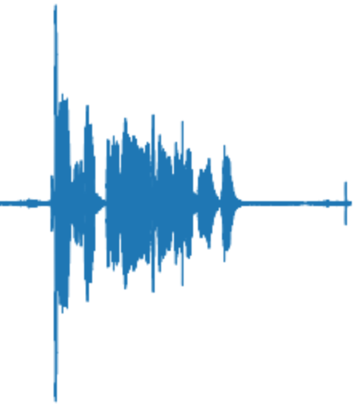
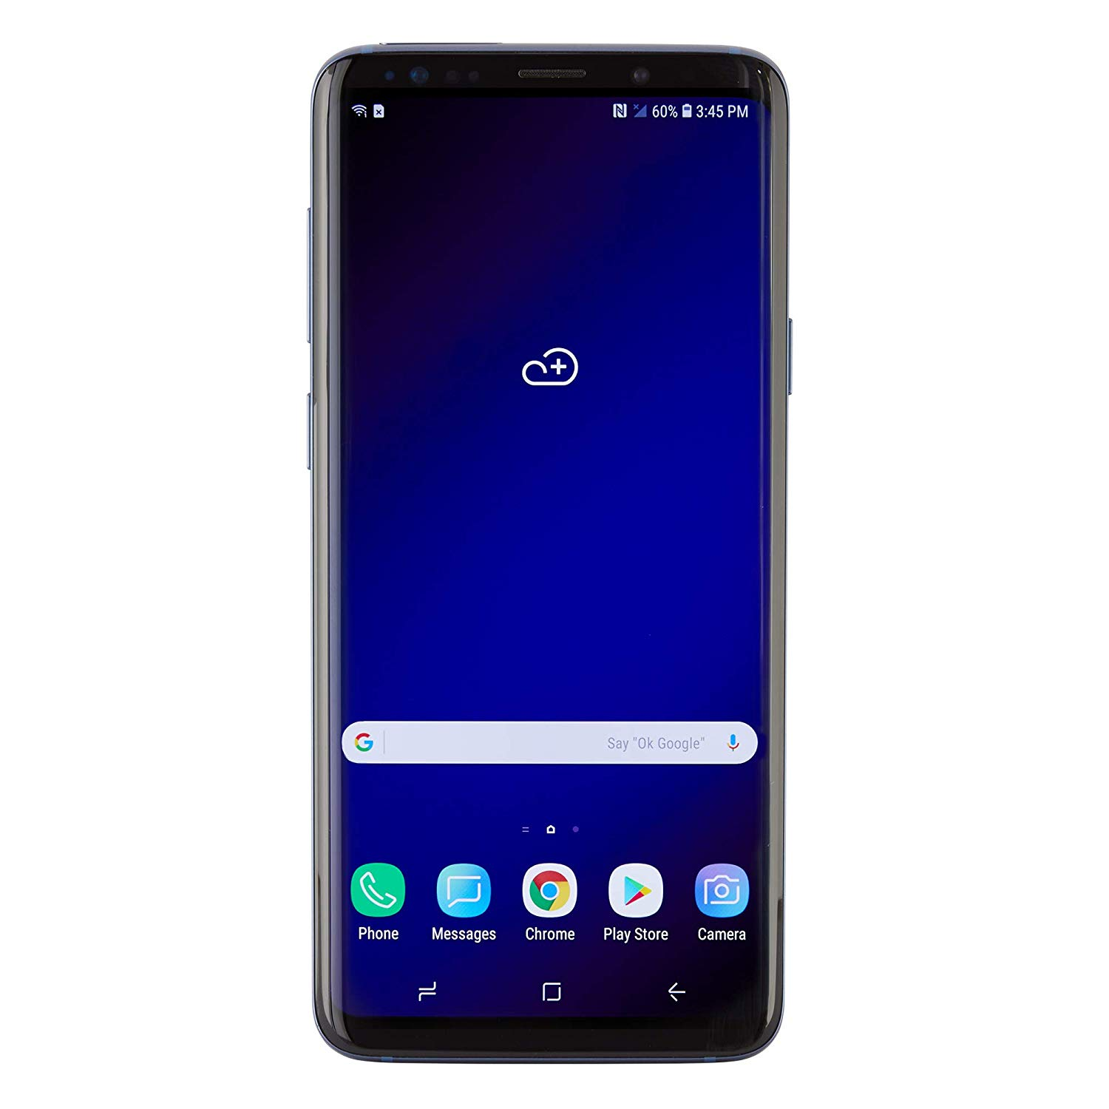
Future development
Misha
Stored Katrina’s voiceprint
Same speaker?
Speaker recognition systems evolve alongside with attackers abilities to fool them
DO NOT LET YOUR CHILD RECORD YOU!
YES
Misha’s phone
Order has been placed

Slide 12
Application example
Plan A:
Recorded android app that opens my phone with my voice but not someone else’s
Try: recording my voice to open the phone
Plan B:
Record two people and authenticate their voices

Slide 13
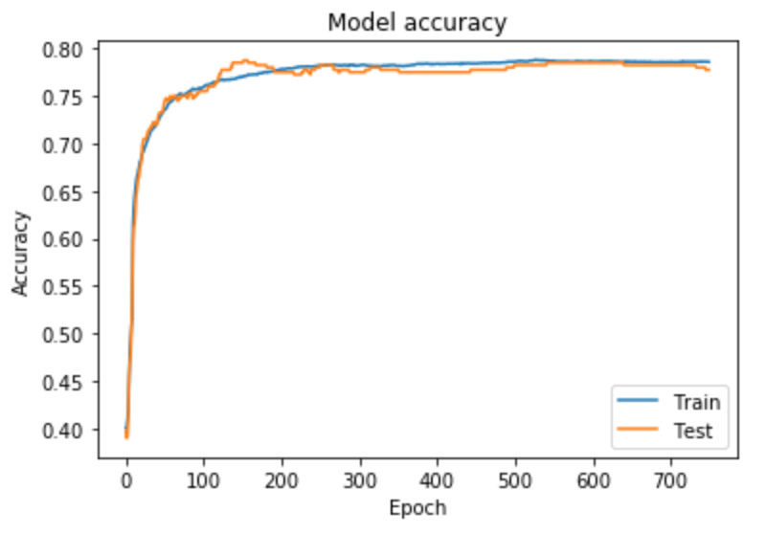
Building a speaker authentication protocol

Slide 14
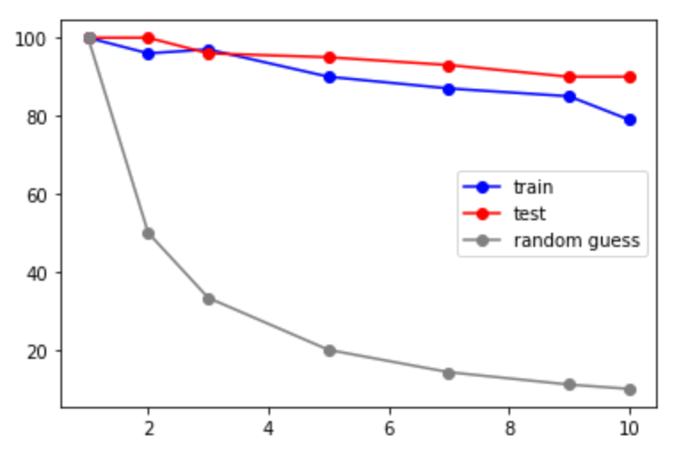
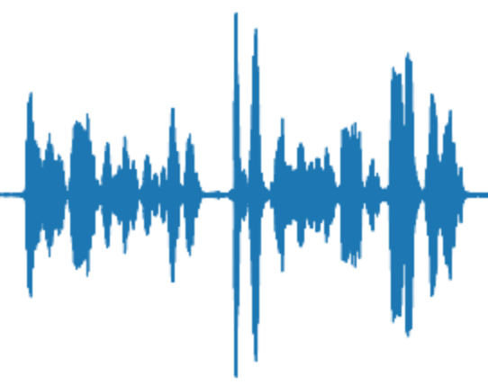
One shot learning performance
4-way learning
✕
✓
✕
✕

Slide 15
Lalalal

Slide 16
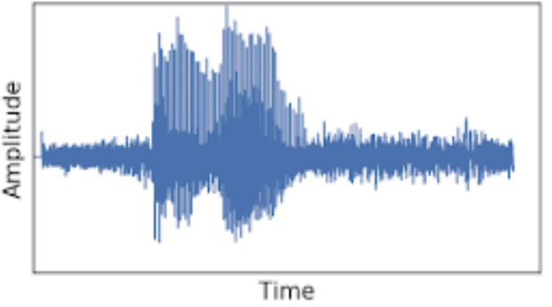
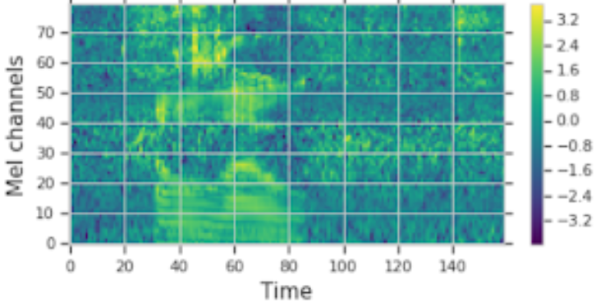
Home-related activities: 10 sound classes
Cooking/cleaning
water tap
microwave
blender
vacuum cleaner
Entertainment
music
speech
clarinet
cat
Moving around
footsteps
opening doors
Features:
sound
spectrogram
VGGish neural networks model
1,280 features

